Slide 1
CLONING VECTORS
Dr. S. Rubanraj
Dept of Mathematics
St. Joseph’s College
Trichy

Slide 2
Vectors
Vector is an agent that can carry a DNA fragment into a host cell in which it is capable of replication. If it is used only for reproducing the DNA fragment, it is called a cloning vector. If it is used for expression of foreign gene, it is called an expression vector.
Vectors are ship for carrying the target DNA into a host cell.
Cloning vector – used for obtaining millions of copies of cloned DNA segment. Used for creating genomic library or preparing the probes or genetic engineering experiments or other basic studies.
Expression vector – allows expression of cloned gene, to give the product (protein). This can be achieved through the use of promoters and expression cassettes and regulatory genes. Used for transformation to generate trangenic plants, animals or microbes where cloned gene expresses to give the product.

Slide 3
Properties of a good vector:
(1) It should be autonomously replicating i.e. it should have ori region.
(2) It should contain at least one selectable marker e. g. gene for antibiotic resistance (tet^{R} for tetracycline resistance).
(3) It should have unique restriction enzyme site (only one site for one RE) for different REs (preferably in one of the marker genes) to insert foreign DNA.
(4) It should be preferably small in size for easy handling.
(5) It should have relaxed control of replication so that multiple copies can be obtained.
(6) It should contain specific control systems like promoters, terminators, ribosome binding sites etc so that the cloned DNA should express properly.

Slide 4
TYPES
Vectors are of different types depending on the host. These are as follows:
1. Bacterial vectors
2. Yeast vectors
3. Plant vectors
4. Animal vectors

Slide 5
Bacterial vectors
E.coli is the most commonly used bacterium for gene cloning though other bacteria such as Bacillus are also used.
Vectors for cloning in these bacteria are described below:
Vectors for cloning in E.coli
A number of vectors are used for cloning in E.coli. Theses are categorized as plasmids, phages, cosmids, phagemids and bacterial artificial chromosomes.

Slide 6
Bacterial plasmid

Slide 7
PLASMIDS
Plasmids are classified
1. by their ability to be transferred to other bacteria
Conjugative
The sexual transfer of plasmids to another bacterium through a pilus. those plasmids possess the 25 genes required for transfer.
Non-conjugative
Non-conjugative plasmids don’t initiate conjugation.
They can only be transferred with the help of conjugative plasmids.
mobilisable
An intermediate class of plasmids are mobilisable, and carry only a subset of the genes required for transfer. These plasmids can 'parasitise' another plasmid, transferring at high frequency in the presence of a conjugative plasmid

Slide 8
2. by function
1. Fertility-(F) plasmids,
They are capable of conjugation (they contains the genes for the pili).
Resistance-(R) plasmids,
contain gene (s) that can build resistance against one or several antibiotics or poisons.
Col-plasmids,
contain genes coding for colicines, proteins that can kill other bacteria.
Degradative plasmids,
able to digest unusual substances, e.g., toluene or salicylic acid.
Virulence plasmids,
turn a bacterium into a pathogen.
addiction system.
These plasmids produce both a long-lived poison and a short-lived antidote.
Daughter cells that retain a copy of the plasmid survive, while a daughter cell that fails
to inherit the plasmid dies or suffers a reduced growth-rate because of the lingering poison from the parent cell.

Slide 9
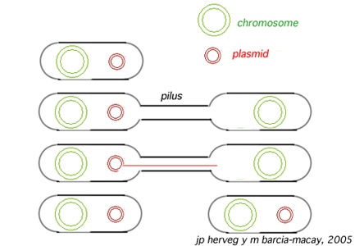
Conjugative plasmids
The sexual transfer of plasmids to another bacterium through a pilus. Those plasmids, F plasmids, possess the 25 genes required for transfer.
Plasmid forms: 1.covalently closed circles –both strands of DNA intact
2. open circles-only one of the two strand is intact
3. Linear.
4.Supercoiled circles.

Slide 10
Plasmid vectors
Plasmids are autonomously replicating circular, double stranded DNA molecules found in bacteria.
They have their own origin of replication (ori region), and can replicate independently of the host chromosome.
The size of plasmids ranges from a few kb to 200 kb. Plasmid vectors are often used for cloning DNA segments of small size (upto 10 kilobases).
Single copy plasmid - maintained as single copy per cell
Multicopy plasmid - maintained as 10-20 copies per cell
Plasmids under relaxed control of replication – over 1000 copies per cell – used as cloning vectors.
In each bacterial cell about 20-25 plasmids are maintained under normal growth condition.
Some of the commonly used plasmid vectors are described below:

Slide 11
pBR322
The first plasmid vector that has been constructed artificially is pBR322.
It is named after the scientists Bolivar and Rodriguiz who constructed it in 1977.
It is 4362bp in size and most widely used cloning vector.
It has an origin of replication derived from a colicin-resistance plasmid (ColE1).
This origin allows a fairly high copy number, about 100 copies of the plasmid per cell.
Plasmid pBR322 carries two selectable markers viz. genes for resistance to ampicillin (Ap^{r)} and tetracycline (Tc^{r} ).

Slide 12
Several (over 40 enzymes) unique RE sites are present within these genes for insertion of foreign DNA (Fig 1).
EcoRIV, BamHI,SphI, SalI,XmaIII, and NruI are present within the gene coding for tetracycline resistance, two sites (HindIII and ClaI) within the promoter of the tetracycline resistance gene and the three sites (PstI, PvuI and ScaI) within the β lactamase gene that provide resistance to ampicillin
When a foreign DNA segment is inserted in any of these genes, the antibiotic resistance by that particular gene is lost. This is called insertional inactivation.
For instance, insertion of a restriction fragment in the SalI site of the Tc^{r} gene inactivates that gene.
One can still select for Ap^{r} colonies, and then screen to see which ones have lost Tc^{r} .

Slide 13
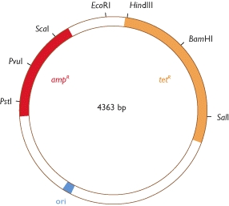
Figure pBR322
The map shows the positions of the ampicillin-resistance gene (amp ^{R}), the tetracycline-resistance gene (tet ^{R}), the origin of replication (ori) and the recognition sequences for seven restriction endonucleases.

Slide 14
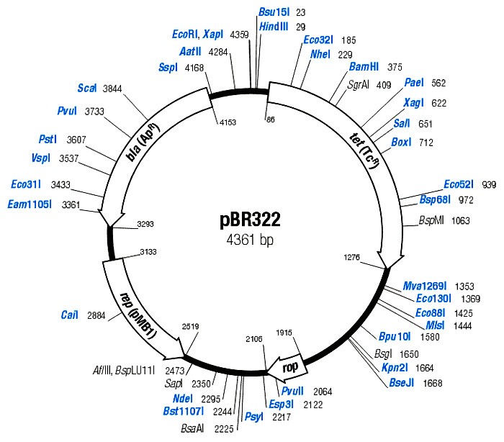
The plasmid pBR322 is one of the most commonly used E.coli cloning vectors. pBR322 is 4361 bp in length and contains: (1) the replicon rep responsible for the replication of plasmid (source – plasmid pMB1); (2) rop gene coding for the Rop protein, which promotes conversion of the unstable RNA I – RNA II complex to a stable complex and serves to decrease copy number (source – plasmid pMB1); (3) bla gene, coding for beta-lactamase that confers resistance to ampicillin (source – transposon Tn3); (4) tet gene, encoding tetracycline resistance protein (source – plasmid pSC101).

Slide 15
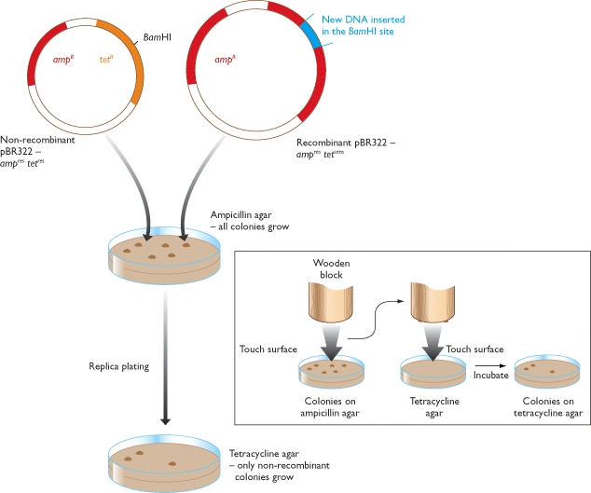
Figure 4.18 Recombinant selection with pBR322

Slide 16
pUC
A series of small plasmids (about 2.7 kb) have been developed (by Messings and co-workers in1983) at the University of California and hence the name pUC e.g. pUC7, 8,9,12,13, 18 and 19 etc.
These are high copy number plasmids that carry an ampicillin resistance gene and an origin of replication, both from pBR322.
They also have a multiple cloning site (MCS) – a sequence of DNA that carries unique sites for many REs.
The MCS contains a portion of lacZ gene that codes for the enzyme β-galactosidase.
When such plasmids are introduced into E. coli, the colonies are blue on plates containing X-gal (5-bromo-4-chloro-3-indolyl-β-d-galactopyranoside, the substrate for β- galactosidase) and IPTG (isopropyl thiogalactoside, an inducer).

Slide 17
Recombinants and non-recombinants can therefore be distinguished simply by plating the transformed cells onto agar containing ampicillin and X-gal.
All colonies that grow on this medium are made up of transformed cells because only transformants are ampicillin resistant.
Blue colonies contain cells with functional β-galactosidase enzymes and hence with undisrupted lacZ′ genes these colonies are therefore non-recombinants.
The white colonies comprise cells without β-galactosidase activity and hence with disrupted lacZ′ genes; these are recombinants.
Thus cells containing recombinant plasmids form white (not blue) colonies.

Slide 18
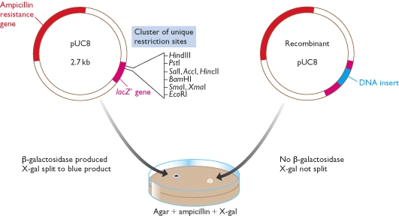
Recombinant selection with pUC8

Slide 19
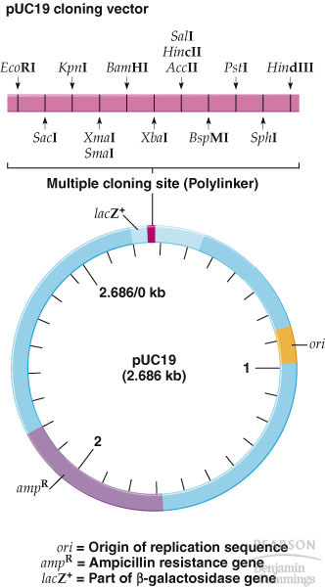
Must have:
1) Ori
2) A dominant selectable
Marker
3) Cleavage sites for cloning
4) (high copy no.)
The plasmid cloning vector pUC19. This plasmid has an origin of replication (ori), an ampR selectable marker, and a polylinker located within part of the β-galactosidase gene lacZ+.

Slide 20
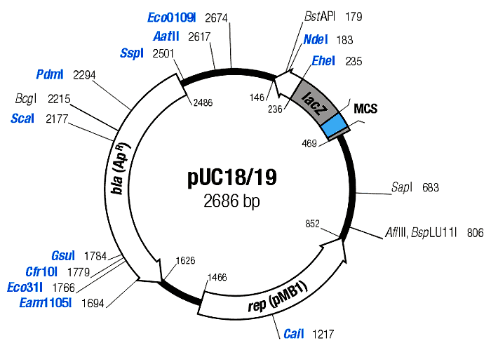

Slide 21
Phage vectors
Bacteriophages or phages are viruses that specifically infect bacteria.
The phage particle attaches to the outer surface of bacterium and injects its DNA into the cell.
The phage DNA is then replicated inside the host and its genes are expressed to make phage capsid proteins and new phage particles are assembled and released from the bacterium.
Phage vectors can accommodate more DNA (upto 25 kb) than plasmids and are often used for preparation of genomic libraries.
They also have higher transformation efficiency as compared to plasmids.

Slide 22
The main reason for seeking a different type of vector was the inability of plasmids such as pBR322 and pUC8 to handle DNA fragments greater than about 10 kb in size, larger inserts undergoing rearrangements or interfering with the plasmid replication system in such a way that the recombinant DNA molecules become lost from the host cells.
The first attempts to develop vectors able to handle larger fragments of DNA centered on bacteriophage λ.
Two bacteriophages namely, Lambda (λ) and M13 have been commonly used for construction of vectors for cloning in E. coli.
The phage can have two modes of life cycles i.e. lytic and lysogenic.
During lytic cycle, it replicates independently in the host cell and produces a large number of phage particles which are released by lysis of the host. Alternatively, it can take up lysogenic growth, meaning that it integrates its DNA into the bacterial chromosome and multiplies along with it.

Slide 23
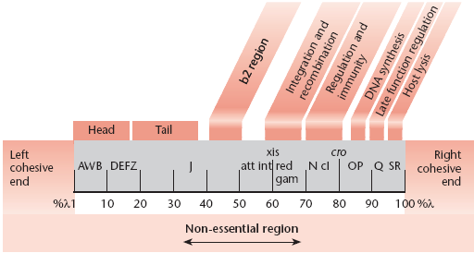
(N, cro, cI genes)
Map of the λ chromosome of wild type .
The genes are not essential for phage growth and can be deleted or replaced without seriously impairing the infectious growth cycle

Slide 24
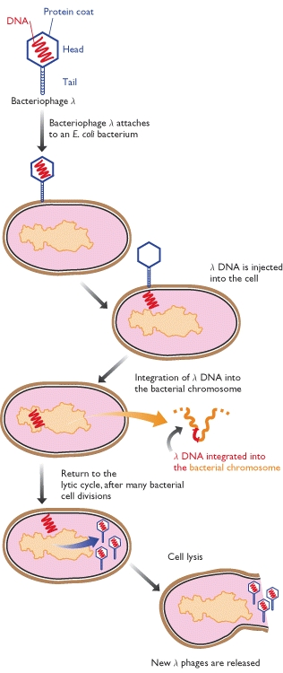
The lysogenic infection cycle of bacteriophage λ
The special feature of the lysogenic cycle is the insertion of the phage genome into the bacterium's chromosomal DNA, where it can remain quiescent for many generations.

Slide 25
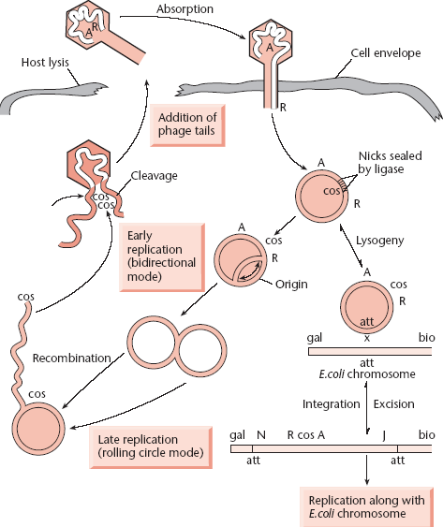
Replication of λ DNA in lytic and lysogenic cycles

Slide 26
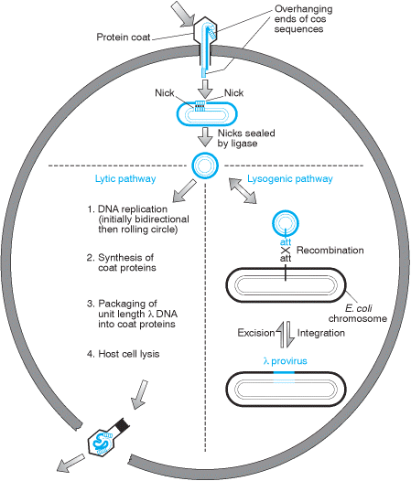

Slide 27
Three temporal stages of λ transcription occurs in the lytic cycle :
early gene transcription establishes the lytic cycle (in competition with lysogeny) - early transcription proceeds from promoters P_{L} and P_{R}, stop at termination sites t_{L} and t_{R1} - transcription is subject to repression by the product of the cI gene .
middle gene products replicate and recombine the DNA – It is directed by N gene product - P_{L} and P_{R} transcripts extend into genes such as red, O and P necessary for the middle stage.
late gene products are packaged into mature phage particles - The cro product accumulate and prevents transcription from P_{L} and P_{R}. Q product is responsible for middle-to-late switch and the Q product specifically anti-terminates the short P_{R} ´ transcript - many mature phage particles are produced.

Slide 28
Lambda (λ) phage vectors
Lambda is a temperate bacteriophage with a genome size of 48.5 kb. Its entire DNA sequence is known.
The lambda genome is a linear, double-stranded molecule with single-stranded, complementary ends. These ends can hybridize with each other (and do so when the DNA is within an infected cell) and are thus termed cohesive (cos) sites.
The λ genome is 48.5 kb, of which some 15 kb or so is ‘optional’ in that it contains genes that are only needed for integration of the phage DNA into the E. coli chromosome. These segments can therefore be deleted without impairing the ability of the phage to infect bacteria and direct synthesis of new λ particles by the lytic cycle.

Slide 29
Two types of vector have been developed:
Insertion vectors, in which part or all of the optional DNA has been removed and a unique restriction site introduced at some position within the trimmed down genome;
Replacement vectors, in which the optional DNA is contained within a stuffer fragment, flanked by a pair of restriction sites, that is replaced when the DNA to be cloned is ligated into the vector.
The λ genome is linear, but the two natural ends of the molecule have 12-nucleotide single-stranded overhangs, called cos sites, which have complementary sequences and so can base-pair to one another.

Slide 30
Insertional vectors have one unique restriction site for a particular restriction enzyme and can accommodate 6-7 kb DNA.
Examples of insertional vectors are λgt10, λgt11 and λZAP II.
On the other hand, replacement vectors have two cleavage sites for a restriction enzyme and can accommodate up to 25 kb DNA.
When vector is cut with a restriction endonuclease, a stuffer fragment is removed and replaced with a foreign DNA.
Some examples of replacement vectors are EMBL3, EMBL3A, EMBL4, λDASH, λFIX, GEM11 and GEM12.

Slide 31
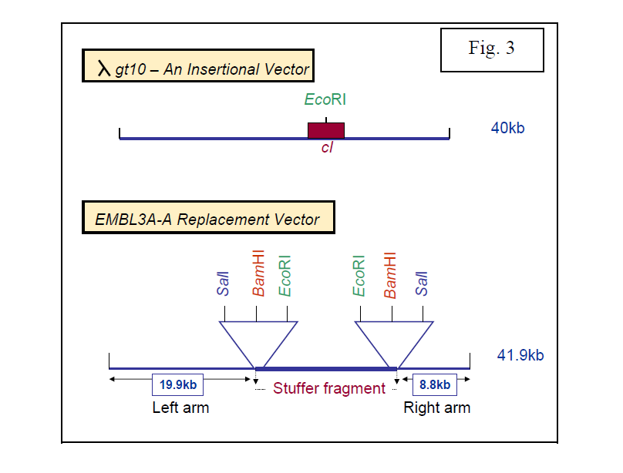

Slide 32
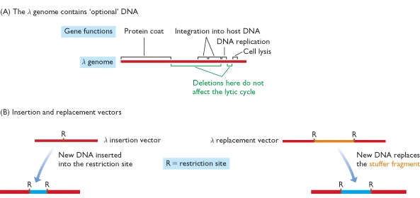
Cloning vectors based on bacteriophage λ
In the λ genome, the genes are arranged into functional groups. For example, the region marked as ‘protein coat’ comprises 21 genes coding for proteins that are either components of the phage capsid or are required for capsid assembly, and ‘cell lysis’ comprises four genes involved in lysis of the bacterium at the end of the lytic phase of the infection cycle. The regions of the genome that can be deleted without impairing the ability of the phage to follow the lytic cycle are indicated in green. (B) The differences between a λ insertion vector and a λ replacement vector.

Slide 33
Bacteriophage lambda can be reconstituted in a test tube by simply mixing phage DNA with a mixture of phage proteins, an infective viral particle with the DNA inside the phage head can be produced. This process is called in vitro packaging.
There is a strict size requirement for the piece of DNA that goes into the phage head. That is, it should not be more than 52 kb and less than 38 kb.
This feature allows only the recombinants to be packaged inside the phage head.
In addition, some lambda phage vectors have a stuffer fragment that carries the β-galactosidase gene.
When it is removed or when foreign DNA is cloned within the gene, β-galactosidase activity may be abolished. The accompanying loss of activity may be used to select recombinant clones.

Slide 34
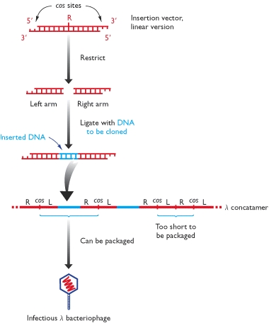
Cloning with a λ insertion vector
The linear form of the vector is shown at the top of the diagram. Treatment with the appropriate restriction endonuclease produces the left and right arms, both of which have one blunt end and one end with the 12-nucleotide overhang of the cos site. The DNA to be cloned is blunt ended and so is inserted between the two arms during the ligation step. These arms also ligate to one another via their cos sites, forming a concatamer. Some parts of the concatamer comprise left arm-insert DNA-right arm and, assuming this combination is 37–52 kb in length, will be enclosed inside the capsid by the in vitro packaging mix. Parts of the concatamer made up of left arm ligated directly to right arm, without new DNA, are too short to be packaged.

Slide 35
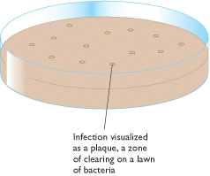
Bacteriophage infection is visualized as a plaque on a lawn of bacteria

Slide 36
DNA cloning with single stranded DNA vectors
These coliphages are developed as cloning vectors
This phage particles have dimensions 900 nm × 9 nm contain a single-stranded circular DNA molecule (6407 (M13) or 6408 (fd) nucleotides long).
they have many advantages over other vectors
M13, f1 and fd are filamentous coliphages containing a circular single-stranded DNA molecule.

Slide 37
The biology of the filamentous coliphages
The phages only infect enteric bacteria harbouring F pili
the end of the F pilus is the adsorption site .
infected cells continue to grow and divide, and extrude virus particles.
Up to 100 phage particles may be released into the medium per cell per generation
Replication of phage DNA does not result in host-cell lysis.
The process of phage transfect and release –
1. The single-stranded phage DNA enters the cell
2. the single-stranded phage DNA is released.

Slide 38
The single-stranded phage DNA enters the cell
the virus discard the capsid proteins
the viral DNA passes into the cell
converted to a double-stranded replicative form .
the decapsidation and replication are tightly coupled.
The RF multiplies rapidly inside the cell until about 100 RF molecules.

Slide 39
a viral-encoded protein accumulated.
The protein binds to the viral strand and prevents synthesis of the complementary strand.
Replication of the RF becomes asymmetric
only viral single strands are synthesized.

Slide 40
Why use single-stranded vectors?
Sequencing by dideoxy method required single-stranded DNA
oligonucleotide-directed mutagenesis required single-stranded DNA.
certain probe preparation required single-stranded DNA.
In summary filamentous phages possess all the
advantages of plasmids and producing particles containing single-stranded DNA in an easily obtainable form.

Slide 41
M13 Phage vectors
M13 is a filamentous bacteriophage of E. coli and contains a single stranded circular DNA of 7.2 kb.
A series of vectors (M13 mp series) have been developed from this phage.
These vectors have a polylinker with unique restriction enzyme sites in lac Z gene that complements host (e.g. JM 103 or JM 104).
Screening of recombinants is done based on formation of blue/white plaques.
M13 vectors are used for obtaining sufficient quantity of DNA for sequencing by Sanger's dideoxy chain termination method.

Slide 42
Cloning vectors and their insert capacities
Vector system | Host cell | Insert capacity (kb)
Plasmid | E. coli | 0.1-10
Bacteriophage λ | E. coli | 10-20
Cosmid | E. coli | 35-45
Bacteriophage P1 | E. coli | 80-100
BAC (bacterial artificial chromosome) | E. coli | 50-300
P1 bacteriophage-derived AC | E. coli | 100-300
YAC | Yeast | 100-2,000
Human AC | Cultured human cells | >2,000

Slide 43
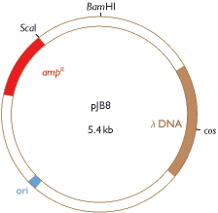
A typical cosmid
pJB8 is 5.4 kb in size and carries the ampicillin-resistance gene (amp ^{R}), a segment of λ DNA containing the cos site, and an Escherichia coli origin of replication (ori).

Slide 44
cosmid vector
The cosmid vector is a combination of the plasmid and bacteriophage lambda. It is small (5-7 kb) circular DNA containing an origin for DNA replication (ori), selectable markers and restriction sites from plasmid plus a sequence from lambda needed for packaging the DNA (cos site). Cosmids may be used to clone large DNA molecules of up to 45 kb. They also have high transformation efficiency. Some examples of cosmid vectors include pJB, PWE and SuperCos series.

Slide 45
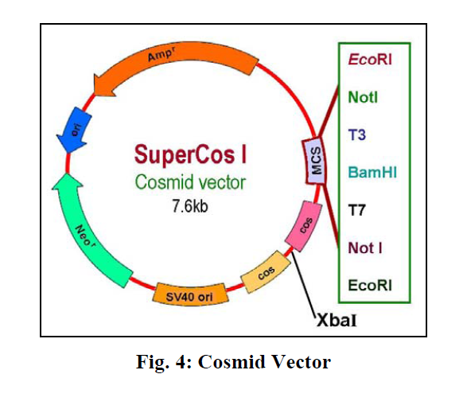

Slide 46
Vectors for cloning in yeast
The discovery of a 2μm plasmid in most strains of Saccharomyces cerevisiae led to the development of cloning vectors in yeast. The 2μm plasmid is 6 kb in size. It is present in 50-100 copies per cell. A number of shuttle vectors based on 2μm plasmid and bacterial plasmids have been constructed which can replicate either in E.coli or yeast. Yeast plasmid vectors are of four types, yeast episomal plasmids (YEps), yeast integrative plasmids (YIps) yeast replicative plasmids (YRps) and yeast centromeric plasmids (Ycps). In addition to plasmid vectors, yeast artificial chromosomes (YACs) are also used as vectors for cloning large pieces of DNA.

Slide 47
i) Yeast episomal plasmids (YEps)
These are derived from 2μm plasmid. Some YEps contain the entire 2μm plasmid; others include just the 2μm origin of replication. An example of latter type is YEp13. It is a shuttle vector and can be replicated both in E.coli and yeast. It contains 2μm origin of replication, yeast gene leu2 as selectable marker and entire sequence of pBR322.The leu2 gene codes for an enzyme involved in biosynthesis of amino acid leucine.
YEps may replicate autonomously or integrate in one of the yeast chromosomes by homologous recombination. They have high transformation frequency of 10,000 to 100,000 transformants/ μg DNA.

Slide 48
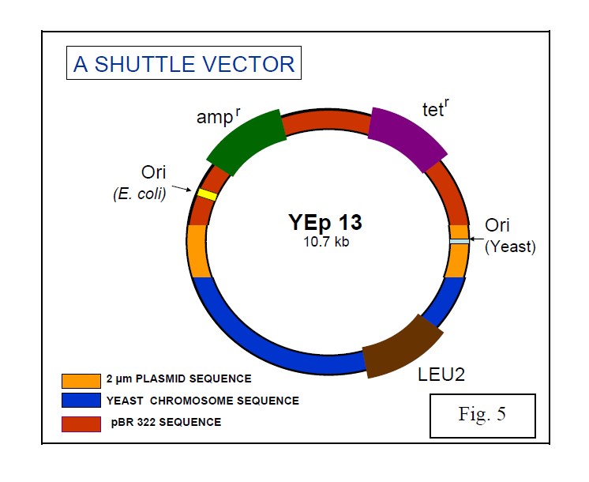

Slide 49
ii) Yeast integrative plasmids (YIps)
These are basically bacterial plasmids carrying a yeast gene. YIp5 is an example of yeast integrative plasmid. It has ura3 gene inserted in pBR322. The gene ura3 codes for an enzyme involved in biosynthesis of pyrimidine nucleotides and acts as selectable marker. The plasmid cannot replicate autonomously as it lacks 2μm origin of replication and survives by integrating in yeast chromosomal DNA. They have very low transformation frequency, less than 100 transformants/ μg DNA.

Slide 50
iii) Yeast replicative plasmids (YRps)
They carry a part of chromosomal DNA with an origin of replication and one or two selectable markers and are capable of independent replication. They have transformation frequency between 1000 and 10,000 transformants/ μg DNA.
iv) Yeast centromeric plasmids (YCps)
These are shuttle vectors that behave as small chromosomes and replicate only once during each cell divison. They contain i) origin of replication called ARS sequence , ii) CEN sequence (for proper segregation of chromosomes) and iii) a selectable marker such as leu2 from yeast and sequences from bacterial plasmid having ori region and selectable marker (Ap^{r}). They are stably maintained at one copy per cell.

Slide 51
v) Yeast Artificial Chromosomes (YACs)
YACs are artificial chromosomes that replicate in yeast cells. Main features of these vectors are:
1. Autonomously replicating sequence (ARS) necessary for the replication in yeast cells (Fig 6).
2. Telomeres (TEL), which are ends of chromosomes involved in the replication and stability of chromosomes.
3. A yeast centromere (CEN), required for proper segregation of chromosomes
4. Selectable markers that allow the easy isolation of yeast cells that have taken up the artificial chromosome.
5. Unique RE sites.
YACs are capable of carrying a large DNA fragment (up to 3000 kb), but their transformation efficiency is very low.

Slide 52
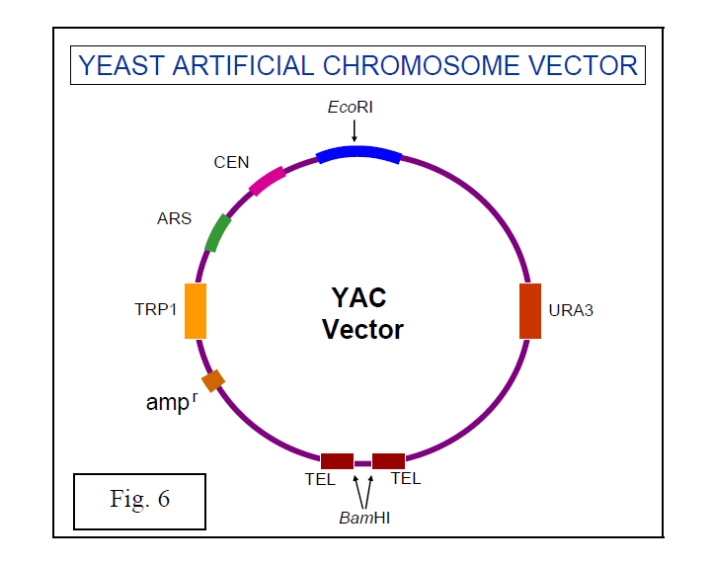

Slide 53
Table 4.4Sizes of human genomic libraries prepared in different types of cloning vector
*
  Calculated from the equation:
  where N is the number of clones required, P is the probability that any given segment of the genome is present in the library, a is the average size
  of the DNA fragments inserted into the vector, and b is the size of the genome.
 |  | Number of clones*
Type of vector | Insert size (kb) | P = 95% | P = 99%
λ replacement | 18 | 532 500 | 820 000
Cosmid, fosmid | 40 | 240 000 | 370 000
P1 | 125 | 77 000 | 118 000
BAC, PAC | 300 | 32 000 | 50 000
YAC | 600 | 16 000 | 24 500
Mega-YAC | 1400 | 6850 | 10 500

Slide 54
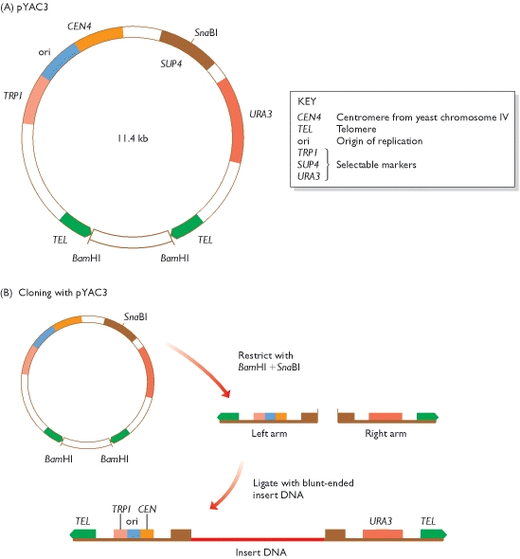

Slide 55
Figure 4.25Working with a YAC
(A) The cloning vector pYAC3. (B) To clone with pYAC3, the circular vector is digested with BamHI and SnaBI. BamHI restriction removes the stuffer fragment held between the two telomeres in the circular molecule. SnaBI cuts within the SUP4 gene and provides the site into which new DNA will be inserted. Ligation of the two vector arms with new DNA produces the structure shown at the bottom. This structure carries functional copies of the TRP1 and URA3 selectable markers. The host strain has inactivated copies of these genes, which means that it requires tryptophan and uracil as nutrients. After transformation, cells are plated onto a minimal medium, lacking tryptophan and uracil. Only cells that contain the vector, and so can synthesize tryptophan and uracil, are able to survive on this medium and produce colonies. Note that if a vector comprises two right arms, or two left arms, then it will not give rise to colonies because the transformed cells will still require one of the nutrients. The presence of insert DNA in the cloned vector molecules is checked by testing for inactivation of SUP4. This is done by a color test: on the appropriate medium, colonies containing recombinant vectors (i.e. with an insert) are white; non-recombinants (vector but no insert) are red.

Slide 56
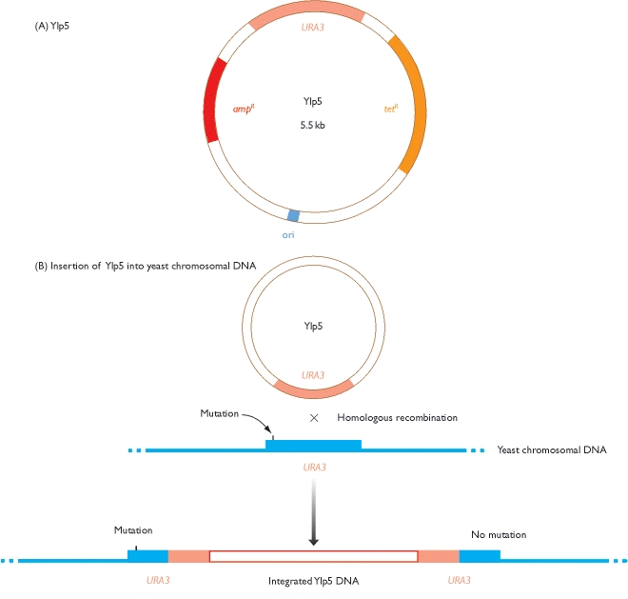

Slide 57
Figure 4.26Cloning with a YIp
(A) YIp5, a typical yeast integrative plasmid. The plasmid contains the ampicillin-resistance gene (amp ^{R}), the tetracycline-resistance gene (tet ^{R}), the yeast gene URA3, and an Escherichia coli origin of replication (ori). The presence of the E. coli ori means that recombinant YIp5 molecules can be constructed in E. coli before their transfer into yeast cells. YIp5 is therefore a shuttle vector - it can be shuttled between two species. (B) YIp5 has no origin of replication that can function inside yeast cells, but can survive if it integrates into the yeast chromosomal DNA by homologous recombination between the plasmid and chromosomal copies of the URA3 gene. The chromosomal gene carries a small mutation which means that it is non-functional and the host cells are ura3 ⁻. One of the pair of URA3 genes that are formed after integration of the plasmid DNA is mutated, but the other is not. Recombinant cells are therefore ura ⁺ and can be selected by plating on to minimal medium, which does not contain uracil.

Slide 58
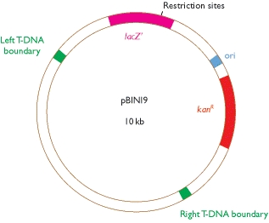
Figure 4.27The plant cloning vector pBIN19
pBIN19 carries the lacZ′ gene (see Figure 4.19), the kanamycin-resistance gene (kan ^{R}), an Escherichia coli origin of replication (ori), and the two boundary sequences from the T-DNA region of the Ti plasmid. These two boundary sequences recombine with plant chromosomal DNA, inserting the segment of DNA between them into the plant DNA. The orientation of the boundary sequences in pBIN19 means that the lacZ′ and kan ^{R} genes, as well as any new DNA ligated into the restriction sites within lacZ′, are transferred to the plant DNA. Recombinant plant cells are selected by plating onto kanamycin agar, and then regenerated into whole plants. Note that pBIN19 is another example of a shuttle vector, recombinant molecules being constructed in E. coli, using the lacZ′ selection system, before transfer to Agrobacterium tumefaciens and thence to the plant. For more details, see Brown (2001).
From: Chapter 4, Studying DNA

Slide 59
  1. Draw diagrams that outline the events that occur during (a) DNA cloning, and (b) PCR. What are the limitations of
  each of these two techniques?
  2. List the types of enzyme used in recombinant DNA research.
3.
  Distinguish between the two types of exonuclease activity that can be possessed by a DNA polymerase, and explain
  how these activities influence the potential applications of individual DNA polymerases in recombinant DNA research.
4.
  Using examples, describe the various types of end produced after digestion of DNA with a restriction endonuclease.
5.
  How are agarose gel electrophoresis and Southern hybridization used to examine the results of a restriction digest?
6.
  Explain why the efficiency of blunt-end ligation is less than that of sticky-end ligation. What steps can be taken to improve
  the efficiency of blunt-end ligation?
7.
  Draw diagrams of (a) pBR322, and (b) pUC8. Explain how the differences between these two vectors influence the ways
  in which they are used to clone DNA fragments.
8.
  Distinguish between the lytic and lysogenic infection cycles for a bacteriophage.
9.
  Write a short description of the way in which a bacteriophage λ vector is used to clone DNA. How does a cosmid differ
  from a standard λ vector?
10.
  Draw a diagram showing a typical YAC. Indicate the key features and explain how a YAC is used to clone DNA.
11.
  What problems might arise when a YAC is used to clone a large fragment of DNA? To what extent can these problems
  be solved by the use of other types of high-capacity cloning vector?
12.
  How is DNA cloned in organisms other than Escherichia coli?
13.
  Describe how a PCR is carried out, paying particular attention to the role of the primers and the temperatures
  used during the thermal cycling.

Slide 60
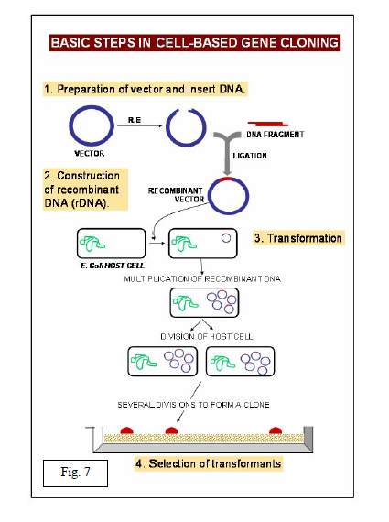

Slide 61
Retroviruses
(including Lentivirus, HIV and MMLV based vectors)
Single stranded RNA genome
Lipid membrane enveloped
Host range determined by envelope proteins
Retrovirus
ssRNA Genome
Reverse Transcription
into dsDNA
Random integration
into host genome
Host DNA
Host Cell

Slide 62
The Retroviral Genome
LTR Ψ LTR
gag pol env
Long Terminal Repeat (LTR): Necessary for integration into host genome
ψ (Psi): packaging signal
gag: Packages viral genome into viral particles
pol: viral polymerase necessary for viral replication
env: viral envelope proteins, necessary for entry into host cells, dictate host range

Slide 63
Design of Replication Incompetent Lentiviral Vectors (3rd Generation)
The viral vector is “gutted” as much as possible to create room for the insert gene and to divide the viral genome into cis- and trans- acting regions
∆
Promoter and Insert Gene
∆
LTR Ψ LTR
gag pol env
Modified LTR
To impede the
Virus from
Performing more
Than one round
Of reverse
Transcription
“self inactivating”
Transfer Vector
Packaging
Vector
Envelope
Vector
Regulatory Signals (LTR and ψ), promoter and Insert Gene
Structural & Packaging Genes (may already be present in packaging line)
Viral envelope protein alters host range of the viral vector

Slide 64
Principles of Retroviral Vector Design
It is possible to make replication-competent retroviral vectors by adding sequences to existing viruses, but a more common design involves the replacement of retroviral sequences to create replication-defective vectors. In addition, the amount of foreign DNA that can be accommodated in replication-competent vectors is much smaller than can be accommodated in replication-defective vectors. Expression of retroviral proteins in most of the naturally occurring oncogenic retroviruses is driven by a single promoter in the 5′long terminal repeat (LTR), and the expression of multiple viral coding regions is achieved by alternative splicing. However, vector design is not limited to the use of the single retroviral promoter with alternative splicing. Other strategies include the use of multiple promoters, insertion of genes in the reverse orientation, and the use of internal ribosome entry sites (IRESs).

Slide 65
Efficient gene transduction and integration depend on the inclusion in the retroviral vector of a number of cis-acting viral elements. These include
(1) a promoter and polyadenylation signal in the viral genome;
(2) a viral packaging signal (ψ or E) to direct incorporation of vector RNA into virions;
(3) signals required for reverse transcription, including a transfer RNA-binding site (PBS) and polypurine tract (PPT) for initiation of first- and second-strand DNA synthesis, and a repeated (R) region at both ends of the viral RNA required for transfer of DNA synthesis between templates;
(4) short, partially inverted repeats located at the termini of the viral LTRs required for integration.
An important general consideration in the design of retroviral vectors is the effect of viral replication on vector structure. After one round of viral replication, the U3 regions in both LTRs are derived from the U3 region originally present in the 3′LTR in the plasmid form of the vector, and both U5 regions are derived from the U5 region originally present in the 5′LTR in the plasmid.
Ordinarily, R sequences should arise primarily from the 5′plasmid LTR, but they may also include 3′plasmid LTR sequences.

Slide 66
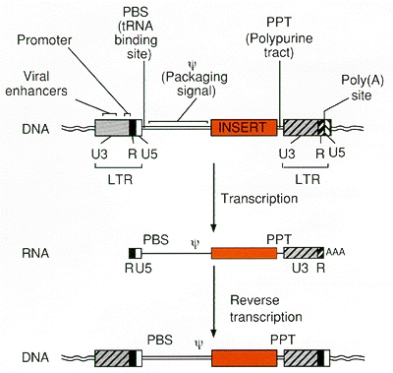

Slide 67
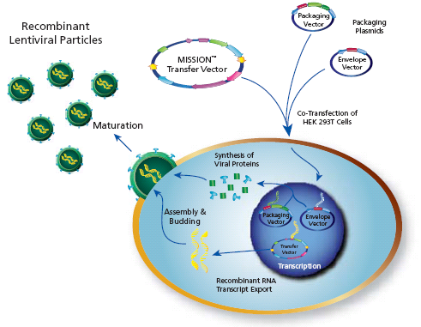
Packaging Recombinant Lentiviral Particles
The three plasmids containing the viral genome components are transfected into the packaging line to create the infectious viral particles.
Multiple plasmids are used so multiple recombination events would be required to reconstitute a replication competent virus.
www.sigma.com/RNAI

Slide 68
Viral Psuedotyping: A Double Edged Sword
Tropism: The ability of a virus to infect a particular type of host cell
Psuedotyping: Altering the viral envelope protein to alter tropism, thus allowing the virus to infect cells it originally could not
Tropism | Host Range | Viral Envelope Protein | Receptor for Viral Envelope
Ecotropic | Mouse / Rat | Gap70 | mCAT-1
Amphotropic / Dualtropic | Mammals | 4070A / 10A1 | Ram-1 / GALV
Pantropic | All Animals | VSV-G | Phosphotidyl serine Phosphotidyl inositol GM3 ganglioside
Special care should be used when working with pantropic or amphotropic viruses which can infect humans!

Slide 69
Replication Deficient Viral Vectors: Genetically Engineered So The Viral Infection Cannot Spread
The viral DNA does not contain the viral genes needed to make more viruses.
Viral DNA
Gene of Interest
Virus
Target Cell Infected With Viral DNA Containing The Gene of Interest
Target Cell
Cell’s DNA
No New Viral Particles are Created
Infection dose not spread

Slide 70
Rescue of Replication Deficient Viruses
by superinfection with Wild Viruses
Wild
Virus
Viral DNA
Gene of Interest
Virus
Target Cell
Cell’s DNA
Complementation:
The genome from the wild virus provides the missing proteins needed for the viral vector to replicate. The superinfected cell functions similarly to a packaging line.

Slide 71
Rescue of Replication Deficient Viruses
by superinfection with Wild Viruses
Wild
Virus
Viral DNA
Gene of Interest
Virus
Target Cell
Cell’s DNA
Recombination:
The genome from the wild virus randomly recombines with the viral vector, providing sufficient genetic material for the viral vector to replicate. The resulting rescued virus may possess pieces of the original insert gene. The viral genome is impossible to predict due to random recombination. The virus may exhibit altered virulence.

Slide 72
Risks Associated with Retroviruses: Insertional Mutagenesis
Viral DNA
Gene of Interest
Virus
Target Cell
Host Cell DNA
Oncogene
Proto-Oncogene
Random integration of viral genome may
disrupt endogenous host genes. Of special concern
Is disruption of proto-oncogenes, which can lead
to increased cancer risk.

Slide 73
Risks Associated with Retroviral Vectors: Viral Transduction
Viral DNA
Gene of Interest
Virus
Target Cell Infected With Viral DNA Containing The Gene of Interest
Target Cell
Cell’s DNA
Individuals infected with the viral vector may express the insert gene at the site of infection.

